Slide 1
Collaboration & Innovation in NZ Supply Chains
Driving Productivity in a Trading Nation
Chris Foord Keynote: 11th September 2025

Slide 2
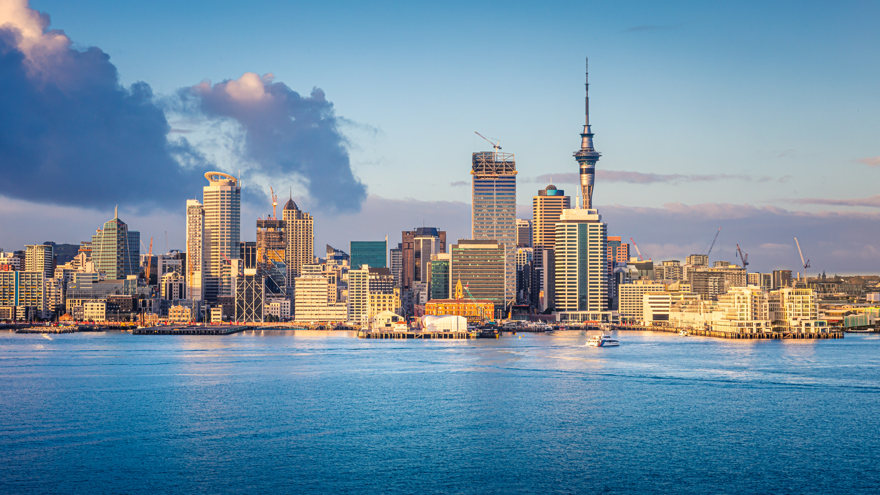


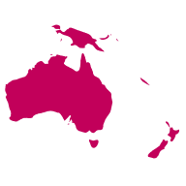

Setting the Scene
Our prosperity depends on the smooth and reliable movement of goods
Supply chains must be efficient, resilient, and innovative
NZ is a trading nation, deeply connected to global supply chains
Disruptions hit NZ harder due to remoteness

Slide 3





The Productivity Challenge
NZ lags in OECD productivity
Supply chain inefficiencies = lost competitiveness
Delays, mismatches, duplication add cost
Opportunity: supply chains as a lever for national advantage
Platform to address these challenges together

Slide 4

Collaboration- Breaking Down Silos
Current issue: fragmented players optimising for themselves
Examples: shared data, coordinated planning, fewer empty containers
Collaboration improves efficiency & resilience
Global lessons: Europe (rail/port integration), Singapore (data visibility)
Association as catalyst: forum for trust, transparency, shared solutions

Slide 5





Innovation- Doing Things Differently
Digitalisation: Real-time data, predictive analytics, digital freight platforms
Multimodal Optimisation: road, rail, sea, low-emission modes
New models: collaborative hubs, 4PL, shared warehousing
Skills for strategic supply chain leadership
Piloting new ideas, creating a learning community

Slide 6


Global Context – Playing on the World Stage
NZ deeply linked to global flows
If slow, costly, unreliable -> we lose competitiveness
Competitors advancing with digital clearance, green shipping corridors
NZ must keep pace or risk falling behind
Helps NZ connect & compete globally

Slide 7



Call to Action
EMBRACE collaborative frameworks (e.g. Association)
INVEST in innovation: tools, infrastructure, skills
SHIFT MINDSET: Supply chins = strategic national asset

Slide 8


A shared Vision
If we collaborate, if we innovate, and if we treat supply chain excellence as a national priority, then we will not only lift productivity – we will create a stronger, more competitive, and more sustainable New Zealand.

Slide 9



Chris Foord
Partner, New Zealand
Chris.Foord@argonandco.com

